Slide 1
Module A.2 Inside A PC
Christian Sookdeo

Slide 2
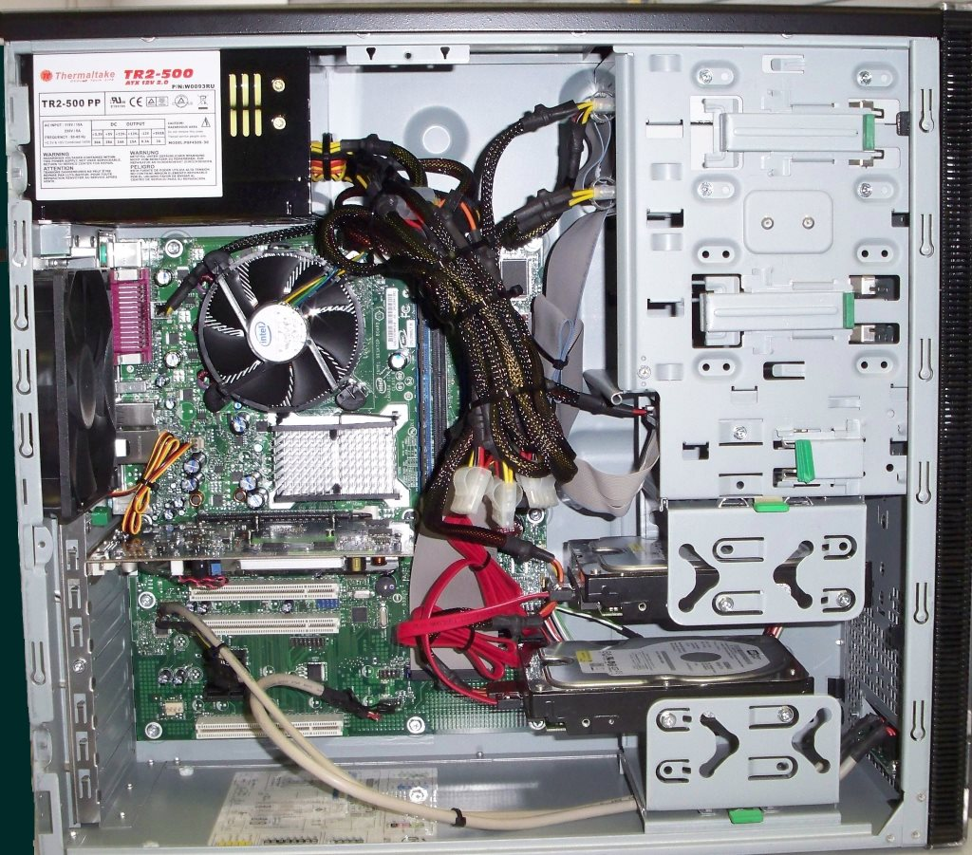
PC Case Internals
Optical Disk Drive
(DVD)
Power Supply
Cooling Fan
Expansion Slots
Motherboard
Hard Disk Drive
USB Expansion Ports
Monitor Port
Ethernet Port
Audio Port

Slide 3
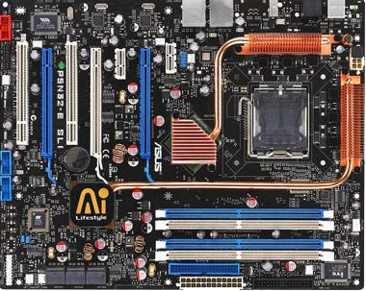
PC Motherboard
CPU
RAM Memory Slots
SATA (Disk Drive
Interface)
GPU Graphics Processor
Sound Processor
WIFI / Ethernet Network Interface

Slide 4
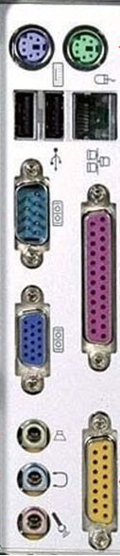
Back of PC Tower
Keyboard Interface (USB or PS/2)
Mouse Interface (USB or PS/2)
USB Ports
Ethernet Interface
Power cord and power switch
Monitor Interface (VGA or DVI or HDMI)
Audio Inputs / Outputs

